Slide 1

Beyond the Blueprint: Building the Patient Centered Medical Home
Northern Physicians Organization
Traverse City, MI
May 29, 2014
Thomas A. Sinsky, MD FACP
Christine A. Sinsky, MD FACP
csinsky1@mahealthcare.com

Slide 2
Agenda
The Challenges of Primary Care
8 strategies to transform practice
Discussion

Slide 3
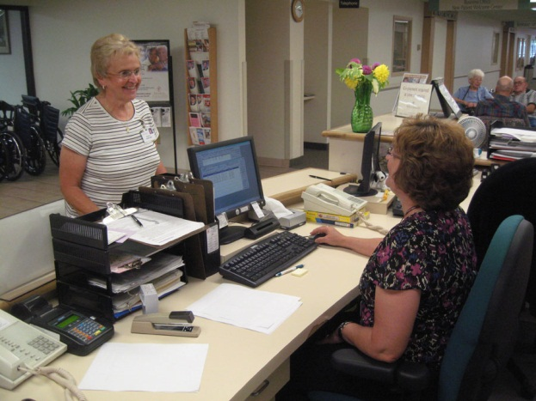
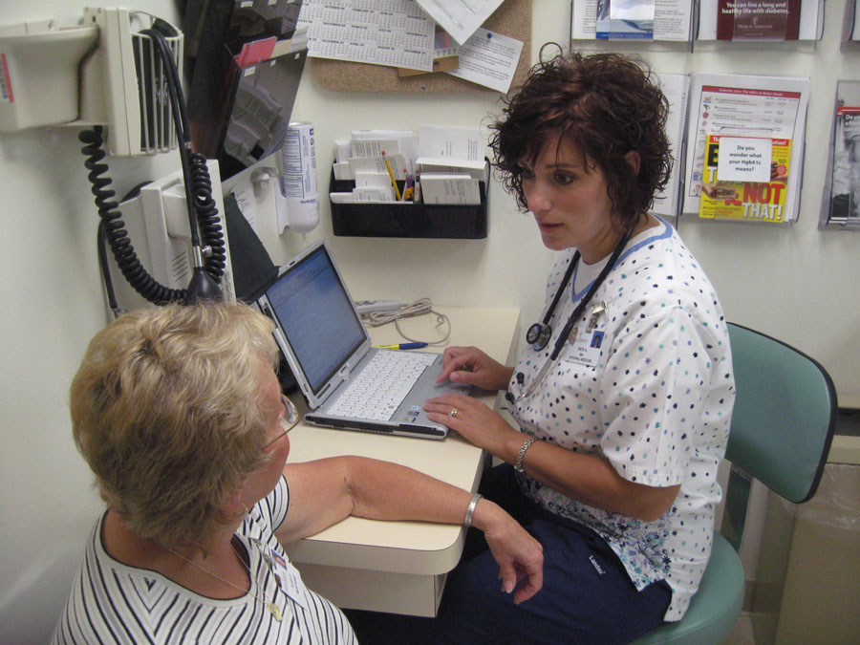

Take Home Messages
It’s all about
  Planning ahead
  Sharing the care
  Enjoying the work!
Notes:
In terms of care management it is all about….
References
Okie. S. Innovation in Primary Care—Staying One Step ahead of Burnout. N Engl J Med 359;22:2305-9
Sinsky CA. Improving Office Practice—Working Harder, Not Smarter. Family Practice Management. 2006;13:.28-36. www.aafp.org/fpm/20061100/28impr.html

Slide 4
Background
Primary Care
PCMH
“Joy in Practice” ABIMF
All trying to solve same equation
  Different settings
  QE & S: quality, efficiency and satisfaction
Notes:
First lets find out something more about each other. How many physicians? Administrators? Nurses? Have I left anyone out? Are you associated with a family practice clinic? IM? Medicine subspecialty? Other?
I’d like you to think about one thing that is working well in your practice and one thing you would like to change.
Working well: relationship with my nurse: she is a full partner with me in the care of our patients.
Would like to improve: would like a scribe; an assistant who not only prepares the patient, but stays with me in the room to do data entry and data retrieval while I interact with the patient.

Slide 5
Goals
How to structure our office practices to
  Take best care of patients
  Do it efficiently
  Remain financially viable
  Enjoy it!

Slide 6

Primary Care →↑ Quality, ↓ Costs

Slide 7
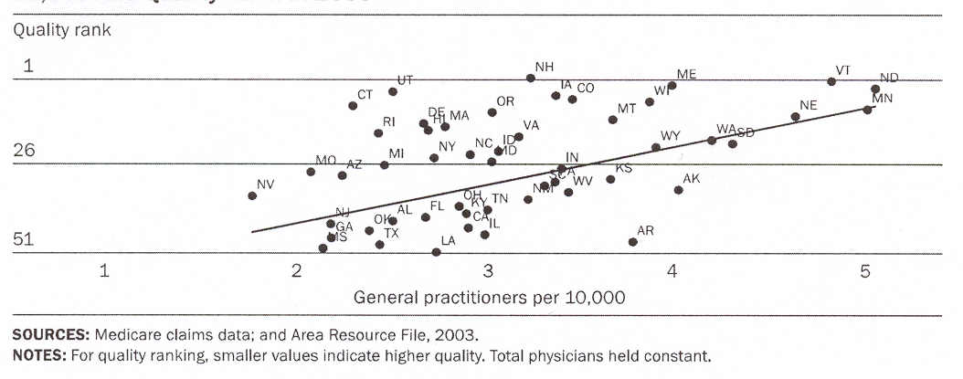
Quality Increases with PCPs
Quality
Rank
1
26
51
1
2
3
4
1
1
5
# of Primary Care Physicians per 10,000
Sources: Medicare claims data; and Area Resource File, 2003.
Notes: For quality ranking, smaller values indicate higher quality. Based on 24 quality measures developed by the Medicare Quality Improvement Organization (for MI, breast CA, DM, CHF, pneumonia, CVA). Total physicians held constant.

Slide 8
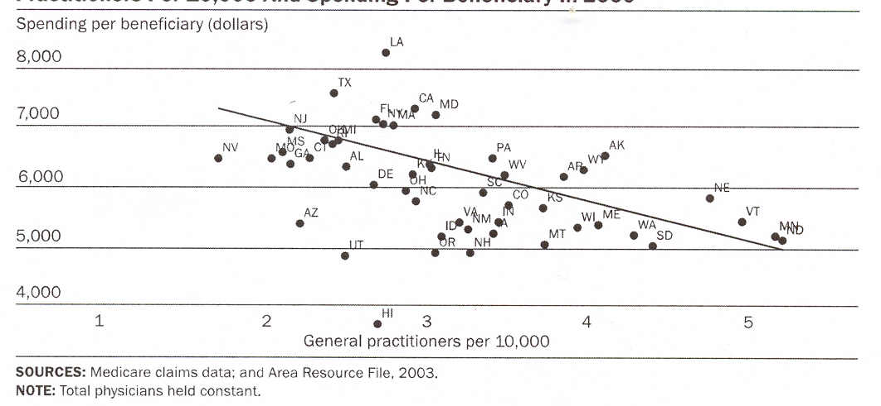
Costs Decrease with PCPs
Spending per beneficiary
8,000
7,000
6,000
5,000
4,000
1
2
3
4
5
# of Primary Care Physicians per 10,000
Sources: Medicare claims data; and Area Resource File, 2003.
Notes: Total physicians held constant.

Slide 9
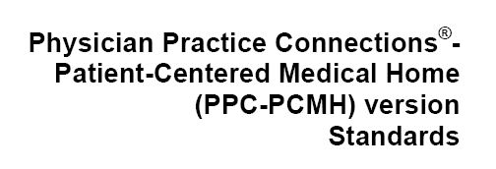

Patient Centered Medical Home
37 pages
171 criteria
Notes:
You can go to the NCQA website and find a 37 page document with 171 criteria…
High tech vs high touch;
Need care management and care navigation and creation of a therapeutic environement

Slide 10

Beyond the Blueprint
How we get there from here?

Slide 11
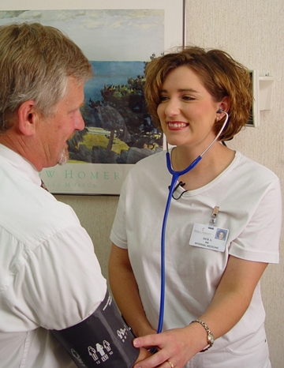
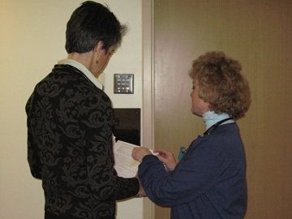
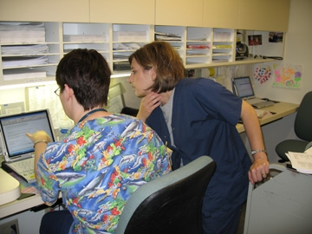
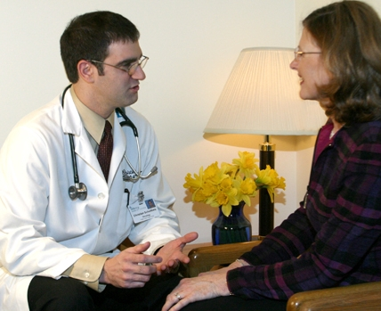
At the center of PCMH are face-to-face healing relationships.
Patient: Nurse
Nurse: Physician
Nurse: Nurse
Patient: Physician
Notes:
Building the physical and human infrastructure that puts human relationships at the center of our care.

Slide 12
We will know who you are and we will be ready for you.
Borgess Ambulatory Care, Kalamazoo, MI

Slide 13
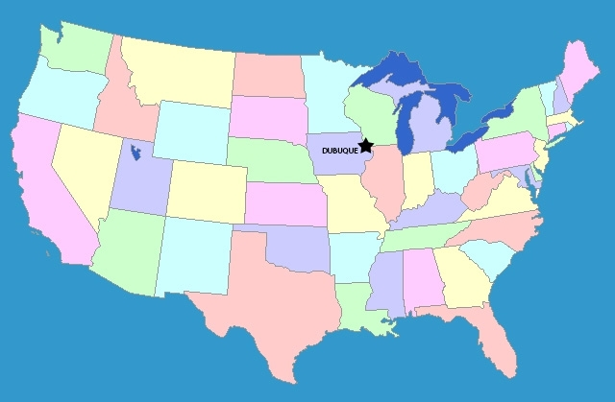

Slide 14
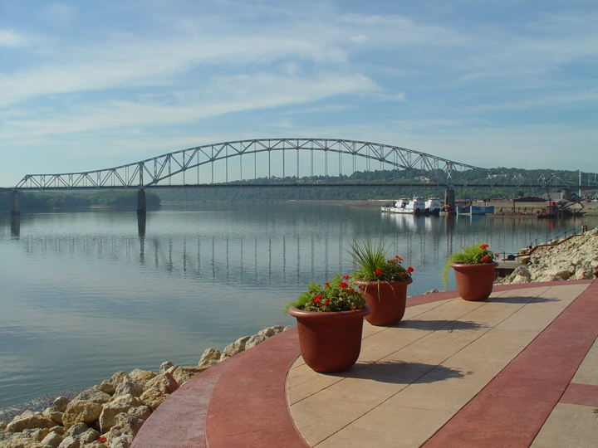

Slide 15
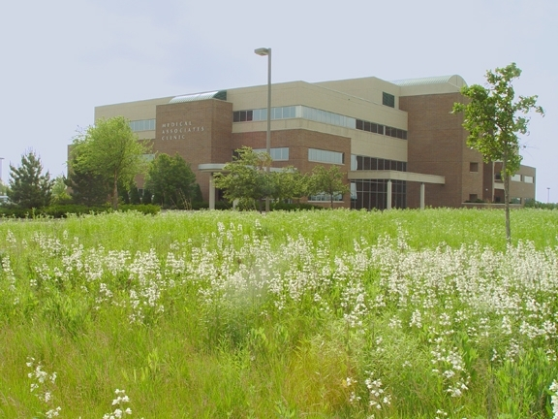
115 physicians, owners
Health Plan: 1/3 of pt pop.
EHR: 2003
Level 3 PCMH: 2008

Slide 16
Satisfaction
Staff turnover < 5%
PCP Satisfaction:
3x nat’l norm AMGA
PCP Productivity & Comp:
85’ile MGMA wRVU = 6025
Notes:
Staff turnover 4.84% 2008

Slide 17
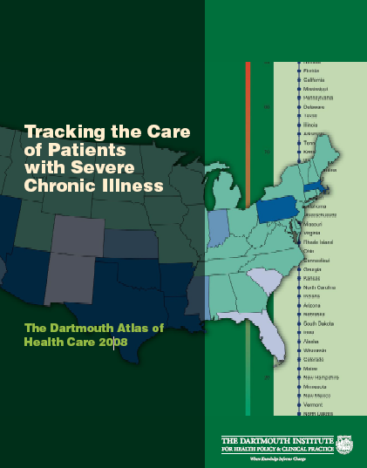
Cost
Cost: Dartmouth Atlas 2008
Dubuque: lowest hospital costs* of 300 regions
Dubuque, IA: $ 15,000
Manhattan: 57,000
2008 Dartmouth Atlas Report
*per Medicare beneficiary with chronic illness in last 2 yr of life
Notes:
I don’t know if this low cost for care is directly to our model of primary care, but it seems reasonable to consider that it may be.
Dartmouth Atlas 2008 report.
http://www.dartmouthatlas.org/atlases/2008_Chronic_Care_Atlas.pdf
p32: “Inpatient sector spending by region: Among hospital referral regions, per patient spending on inpatient care varied almost fourfold, from about $15,000 in Dubuque, Iowa to more than $57,000 in Manhattan.”
For those who like more accessible sources of data, Consumer Reports also picked this up
http://www.consumerreports.org/health/doctors-hospitals/hospital-care/aggressive-medical-care/geography-and-health-care/aggressive-medical-care-geography-and-health-care.htm
“The cost differences are vast. Average Medicare spending over the last two years of life for all hospitals ranged from a high of $81,143 in Manhattan to a low of $29,116 in Dubuque, Iowa.” (I’m not sure why the two sets of #s in the comparisons of Dubuque and Manhattan.)

Slide 18

Cost
Cost: Commercial Population
Dubuque: 2nd lowest total costs of care 382 regions
Dubuque, IA: $ 2,700
Anderson, IN: 7,200
*per employer-based insurance; 2009 spending
http://thomsonreuters.com/content/healthcare/pdf/white_papers/474284

Slide 19
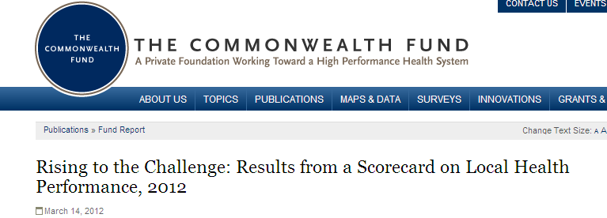
Overall Health System Performance
Cost
Dubuque: 2nd highest on 2012 Commonwealth Fund ranking incorporating access, quality of care, avoiding preventable admissions, healthy lives
http://www.commonwealthfund.org/Publications/Fund-Reports/2012/Mar/Local-Scorecard.aspx

Slide 20
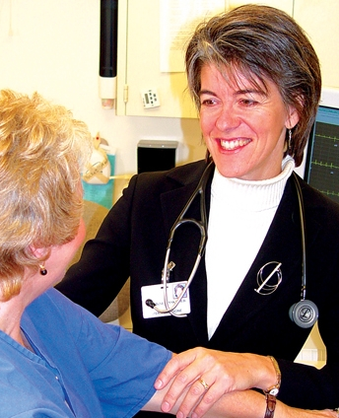
Snapshot of Practice
Staffing
  2.5 nurse: MD
  stable team
  (no MAs)
Space
  3 exam rooms
Scheduling
  1 Receptionist: 2 MDs
Notes:
1 receptionist: 2.25 MDs

Slide 21
Snapshot of Practice
Typical Schedule
  4-6 Annual
  8-10 Planned Care
  4-6 Rapid Access
Panel Size
  1600-1800
Outpatient/Inpatient

Slide 22
Episodic Care
Check-in receptionist
Room pt
MA
MD
Check-out
Medication reconciliation
History
Exam
Data Gathering
Data entry
Decision making
Relationship building
Prescription writing
Documentation
Paperwork
Behavior Modification
Results reporting
Order entry
Insurance verification
Collect
co-pay
Verify contact info
Vital signs
?
½ MA: MD
Notes:
When I first started in practice I think I conceived of medical as episodic care. Many of the structures with which we interact (staffing, EHRs, billing) still conceive of care in this way.

Slide 23
Work Within Skill-set of Others
Check-in receptionist
Room pt
MA
MD
Check-out
Medication reconciliation
History/History
Exam
Data Gathering
Data entry
Decision making
Relationship building
Prescription writing
Documentation
Paperwork
Behavior Modification
Results reporting
Order entry
Insurance verification
Collect
co-pay
Verify contact info
Vital signs
?
½ MA: MD

Slide 24
“In few other sectors of the economy is the highest-level professional responsible for the majority of production, customer service, and clerical work.”
SGIM Blue Ribbon Panel Report. Redesigning the Practice Model for General Internal Medicine: A Proposal for Coordinated Care. J Gen Intern Med 2007;22:400-109

Slide 25
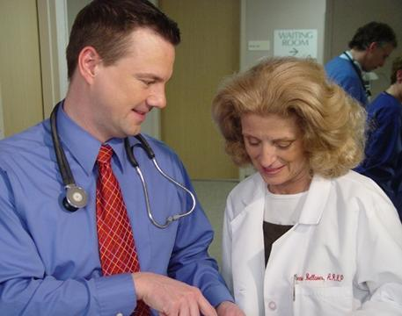
Integrated, Continuous Care
Pre-visit
planning
Build-in
rather than
Carve-out
Office Visit
Nurse-MD Team
MA-MD Team
Between Visit Care
Efficiencies and care coordination

Slide 26
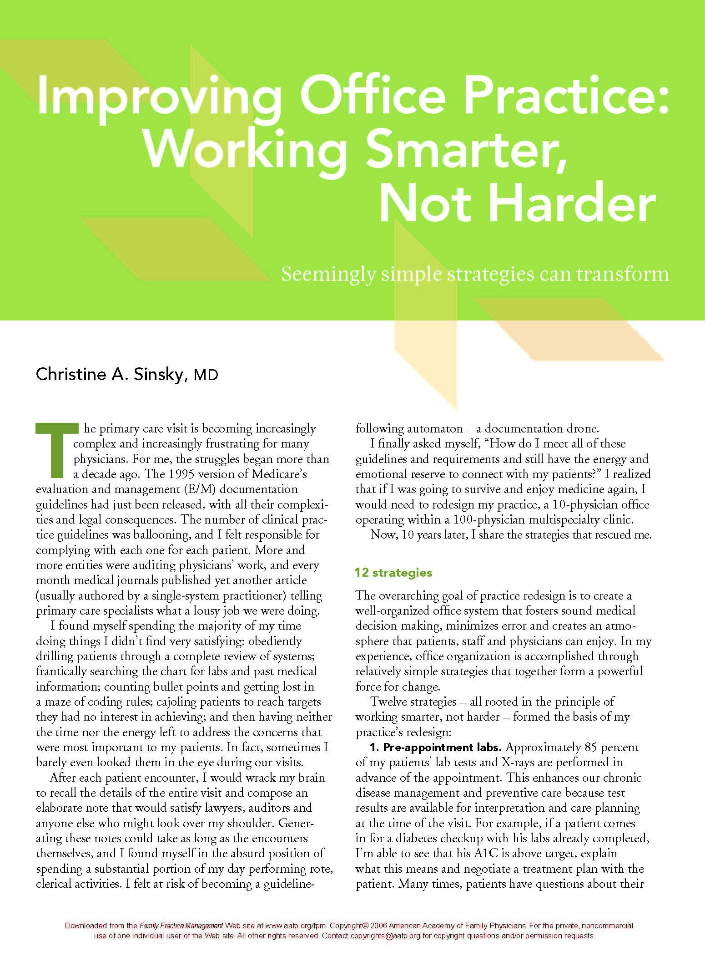
Core Team Model
Planned Care Appt
Visit Planner
Empowered Team
Pt. Questionnaire
Prescription Mgm’t
Annual Exam
Rapid Access
Goal: re-engineer work to eliminate make-work,
Satisfied, not depleted
Notes:
These strategies are aimed at the most granular level of the practice: at workflow, and task distribution, with the goal of re-engineering the work to eliminate re work make work and misdirected work out of the practice, so that at the end of the day given the best care to our pts, staff and physicians feel renewed and replenished rather than depleted, and will want to come back the next day, and the next year.

Slide 27
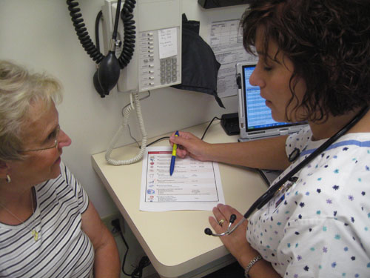
Planned Care Appointment
Majority of lab ahead
Shared decision making
  At the time of appt.
Efficiency
  Close the loop during appt
  4 hr clinic → 2 hr post-appt
Safety
  Missing/overlooked inform
  Pt & family safety net
Notes:
Efficiency
“Just in time” info processing
Once, in context
At time of decision making
Close the loop during that appt
Pt’s work is done
MD’s work is done
Eliminates re-work
Saves an hour per day
Time spent on results reporting and post-visit f/u?
2 hour of post-appt work
4 hour of clinic work
I’d like you to think for a minute about how much time do you spend on results reporting and paperwork and other visit follow up work each day?
Reduces turbulence, time and errors in results reporting. Frees up physician and staff to focus energy on other important patient care issues.

Slide 28
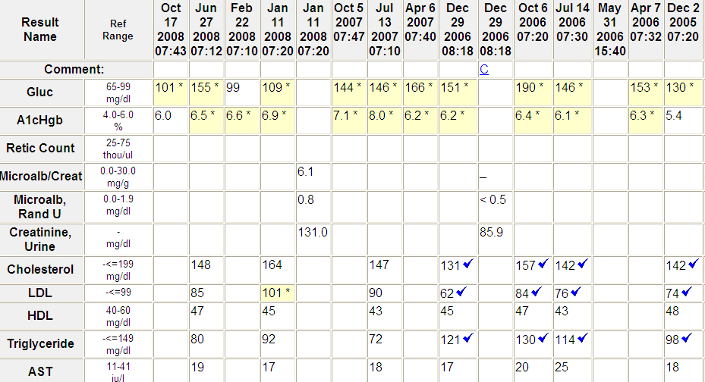
Lab Summary

Slide 29
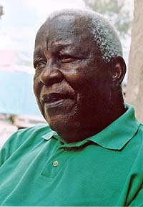
Planned Care Appointment
Planned Care Appt
Order sets
Empowered Team
Pt. Questionnaire
Prescription Mgm’t
Annual Exam
Rapid Access
Intentional Behaviors
63 y.o. diabetic
  A1c 6.3
  LDL 160
Cousin Bill

Slide 30
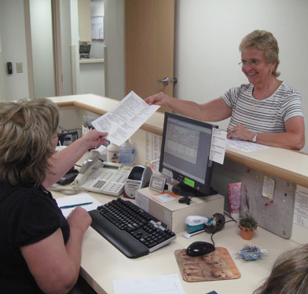
Visit Planner
The next appointment starts today
Planned Care Appt
Visit Planner
Empowered Team
Pt. Questionnaire
Prescription Mgm’t
Annual Exam
Rapid Access
Intentional Behaviors
Notes:
Physicial manifestation of organizational framework
Efficiently get through the day
Tool to support coordination of complex care

Slide 31
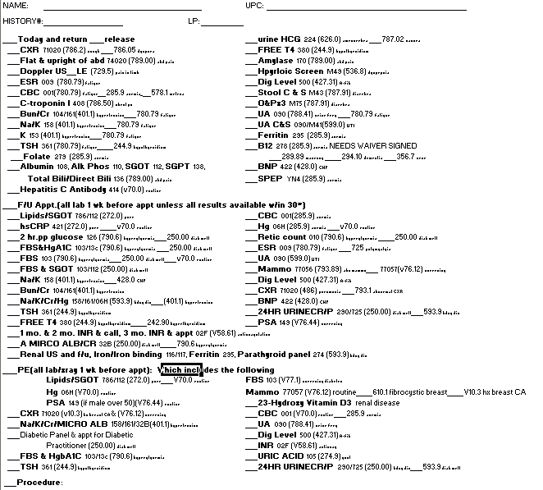
Acute Symptom Evaluation

Slide 32
Planned Care Appt

Slide 33
Annual Comprehensive Care Visit

Slide 34
Upcoming appts/lab
Last PE
Place Today’s Care in Continuum of Time

Slide 35
Visit Planner
The next appointment starts today
MD completes
Pt to receptionist
Built in
  Decision support
  Order sets
Orchestrate
complex care
Plan& promise
Notes:
Do today’s work (planning next visit) today, when no additional re-work is required. Rather than put off today’s work until just before the next visit, which requires re-work as another person must get familiar with the medications/diagnoses, and also also courts more defects.
Physical manifestation of organizational framework .
Our next strategy is the post appointment order sheet. This is one of the two handouts that you received this morning on the way in. If you like, you can take it out and FOLLOW along with me..
“So”, you say, “BIG DEAL, a piece of paper with lots of ABREVIATIONS AND NUMBERS.”
Well, in fact, it is kind of a big deal for me, because this is the TOOL that gets me through my clinic each day.
This FORM gives me the POWER to MANAGE and INTEGRATE all the COMPLEX COMPONENTS of my patients” care: ACUTE SYMPTOM EVALUATION , chronic disease MANAGEMENT and PREVENTION and I can do it LITERALLY in SECONDS with a few simple CHECK MARKS.

Slide 36
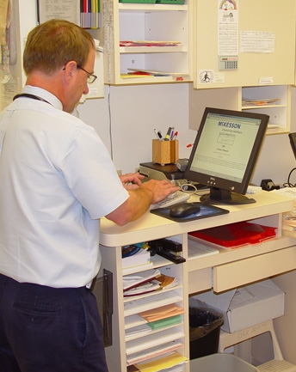
Visit Planner
The next appointment starts today
Order sheet
  3 sec/pt
  100 pt/week x 3 sec/pt =
  5 min MD time/wk
CPOE
  2 min/pt
  100 pt/wk x 2 min/pt =
  3.3 hr MD time/wk
  (= $1000 revenue/wk)
Notes:
We have found that a hybrid works. In our system

Slide 37
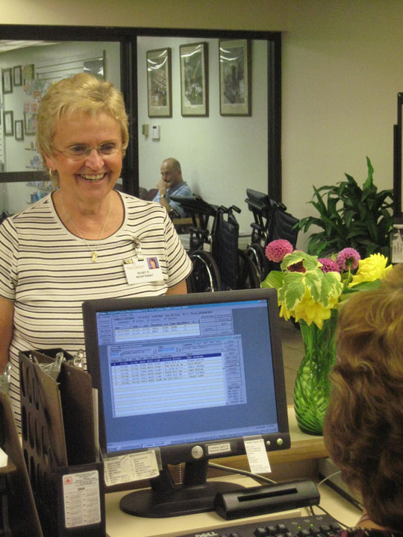
Visit Planner
The next appointment starts today
A plan, a promise to
continue the relationship
“We want to see you again,
and we will plan ahead to
make that most meaningful.”

Slide 38

Process Mapping
“If you can’t describe what you’re doing as a process…
… you don’t know what you are doing”
W. Edwards Deming

Slide 39
Process Mapping
Post-appt Lab
Appt
(review lab from
6 mo ago A1c)
MD reviews
lab, pulls up record
and
reconstructs context
MD contacts
patient with
management
advice (metformin)
Lab
Results
Work
List
For each step ask
How much time does it take?
Does it add value?
Can it be eliminated?
Can the process be done in a different order?
Is it being done by the most appropriate person?
Calls MD
Pt left with
questions
Non-
adherence

Slide 40
Process Mapping
Post-appt Lab
Appt
(review lab from
6 mo ago A1c)
MD reviews
lab, pulls up record
and
reconstructs context
MD contacts
patient with
management
advice (metformin)
Lab
Results
Work
List
Outdated
lab
Fragmented
bits of data
Re-work
Extra work
For each step ask
How much time does it take?
Does it add value?
Can it be eliminated?
Can the process be done in a different order?
Is it being done by the most appropriate person?
Calls MD
Pt left with
questions
Diminished
communication
Extra work
Non-
adherence
Patient
inconvenienced

Slide 41
Process Mapping
Pre-appt Lab
Appt
Book lab
ahead
Automated
Reminder
Call
Pt goes to Lab
Appt
(w/current lab)
Current data for visit
Increases patient involvement
Increases patient safety
Saves time
Eliminates re-work
Decreases no-shows
Decreases non-adherence

Slide 42
Questions
or
Comments?

Slide 43
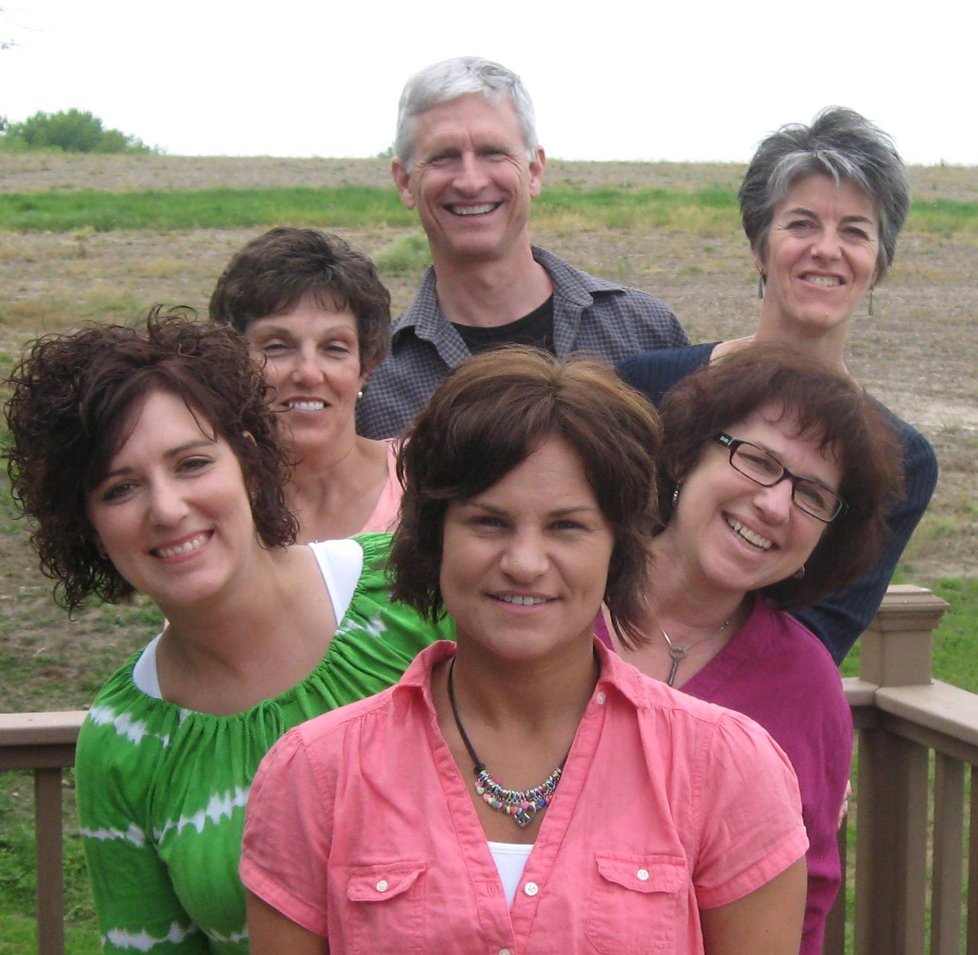
Empowered Teamwork
Planned Care Appt
Visit Planner
Empowered Team
Pt. Questionnaire
Prescription Mgm’t
Annual Exam
Rapid Access
Intentional Behaviors

Slide 44
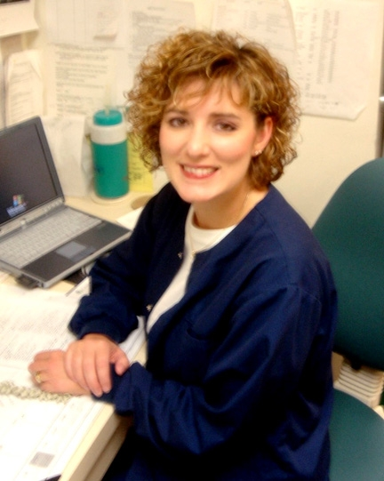
Nexus of organization of our practice
Between Visit
Extension of me when dealing with patients; patients recognize this.
Coordinates transitions (hospital, NH, Hospice)
Manages & returns most phone calls
Processes prescriptions, paperwork
Updates EHR
Visit
Med. Reconcil.
Initial review of lab
Pt education
Immunizations
Colonoscopy
Diabetic foot exam/eye exam
AWV
Standardized, predictable
The Boss
Notes:
The boss at her command center.
When preparing a patient in the room, the nurse will give any needed immunizations, do diabetic foot exam, schedule eye exam, initiate patient education for calcium, weight, do symptom appropriate tests (EKG, PFT). Some of my partners have their nurses schedule colon screening
“BTW, CS is coming in tomorrow. She just moved back to town and is overdue for her annual exam”. Deb had arranged for her lab and mammo ahead of time. The mammo was abnormal and bx was recommended, so Deb set up an appt in surgery to follow ours.
She happened to mention it to me the day before the appointment, but she might have just told me about the patient as I prepared to go in the room.

Slide 45
Mini-huddle
Planned Care Appt
Order sets
Empowered Team
Pt. Questionnaire
Prescription Mgm’t
Annual Exam
Rapid Access
Intentional Behaviors
Medical and social
Mentor nurses
Staff deeply engaged
Stronger handoff

Slide 46
Core Team: Mini-huddle
47 yo “Rapid Access” new patient
CC: dysphagia
Nurse Mini-huddle
  “She seems depressed”
  “Is anyone hurting you?”
Physician better prepared

Slide 47
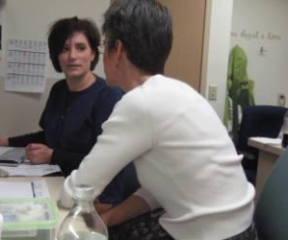
Pre-clinic Huddle
RN-MD 10 min day before
Identify planning needs
  Abnormal CT: review
  Celiac Sprue: UptoDate
Notes:
“Joan said you see your FBS 118 as a ‘wake-up call’. What do you think you can do about it?
LBP: identify pt’s objective “just wants a work release” vs seeking help with management
“The real reason I came in was….”
Sometimes pts tell nurses things they won’t tell the MD:
They don’t want to disappoint me
Pt to RN: “she’ll be mad at me”
If I know that the patient is feeling disappointed or embarrassed I approach the interaction and shape the conversation differently

Slide 48
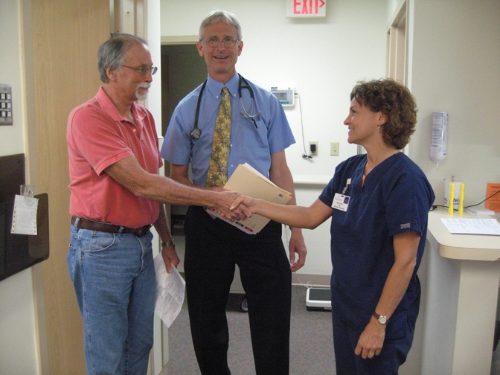
Central Role of Nurses
Notes:
1 RN: 8 MDs

Slide 49
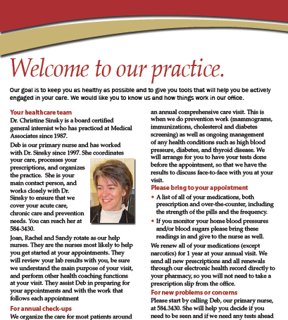
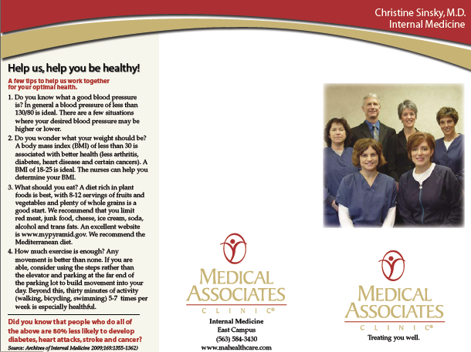
Welcome to Our Practice
“Start here first”
Notes:
1 RN: 8 MDs

Slide 50
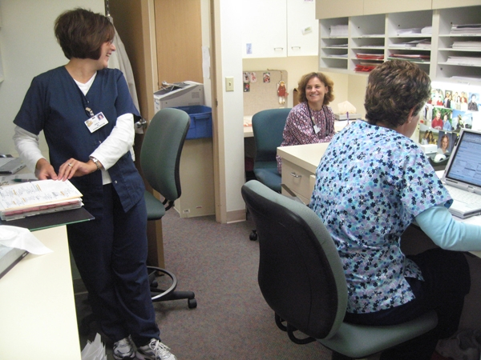
Creating a Culture of Teamwork
Notes:
50

Slide 51
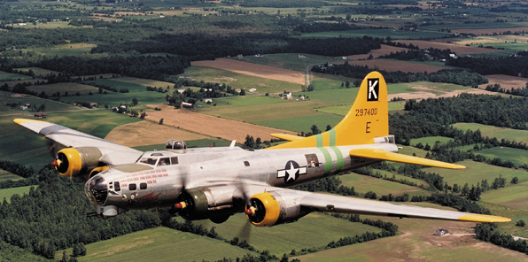
Team Meetings
Re-engineering during the work day is like trying to repair the airplane while it is flying at 20,000 feet.
Notes:
51

Slide 52
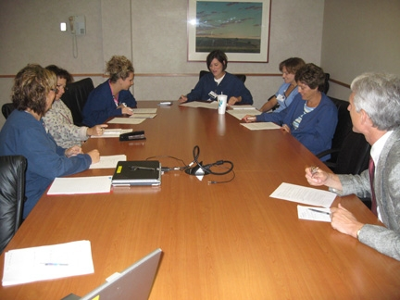
Creating a Culture of Teamwork
Notes:
52

Slide 53
Team Meeting: Components
Meeting q 2 weeks
Participants:
  2 MDs
  4 nurses
  Receptionist
  Nurse Manager
Notes:
53

Slide 54
Team Meeting: Agenda
Check in 1:00-1:10
Check-back 1:10-1:20
Refinement of Workflow 1:20-1:45
Education 1:45-2:00
  Alcohol, smoking cessation, weight loss, medication adherence diabetes, sleep apnea

Slide 55
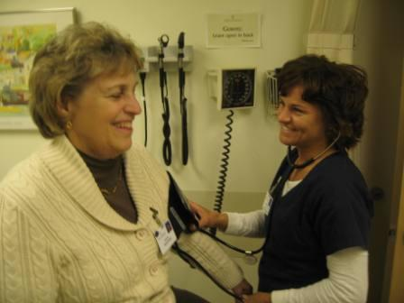

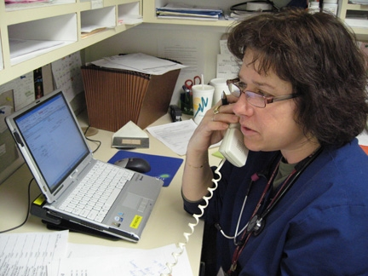
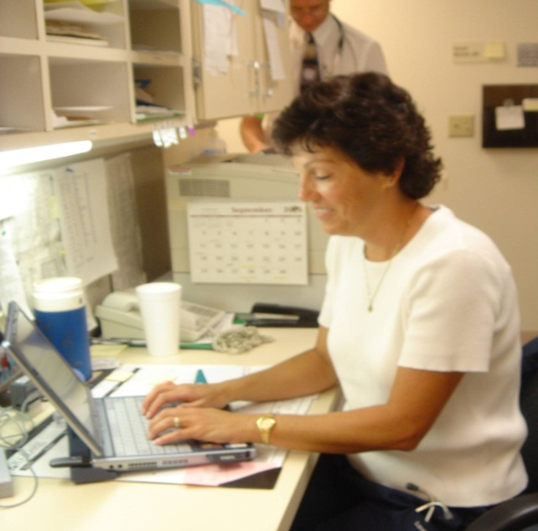
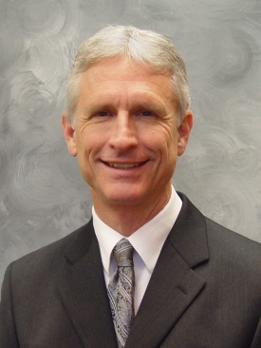
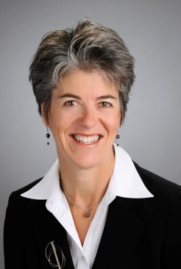
Every Smoker Every Visit
Only 50% of smokers recall receiving advice to quit smoking bc of overfull agendas

Slide 56



Slide 57
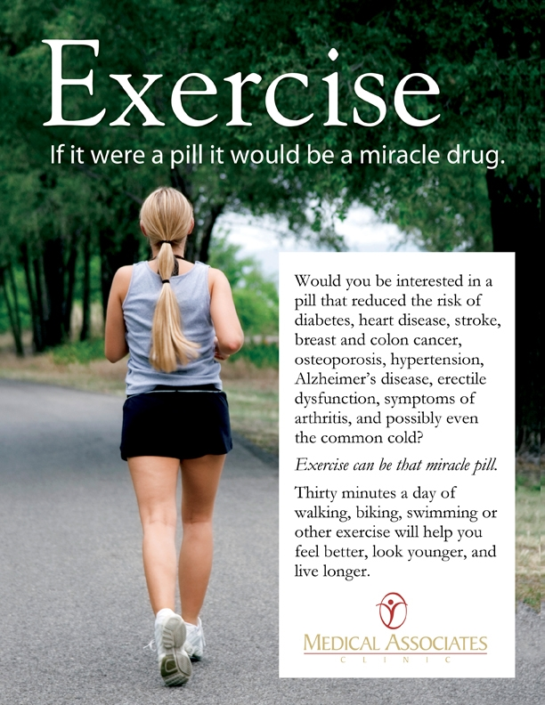
What are Benefits of Exercise?
Reduces risks of
  Diabetes (60%)
  Heart disease
  Stroke
  Hypertension
  Breast cancer
  Colon cancer
  Osteoporosis
  Alzheimer’s disease
  Erectile dysfunction
  Arthritis
  Possibly even common cold

Slide 58
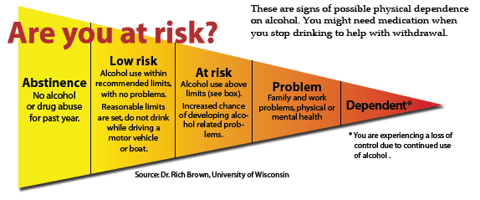
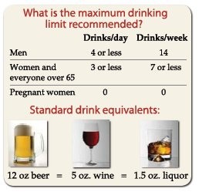
Brief Intervention alcohol

Slide 59
Medication Adherence
Drugs don’t work in patients who don’t take them
Former Surgeon General C. Everett Koop

Slide 60
Team Meetings
Protected time for communication, mentoring
Attention to nitty-gritty details
Everyone sets the agenda
Staff as problem solvers
Feedback from those doing the work
Continually refine the choreography of work day
Notes:
60

Slide 61
Business Case
How can you possibly afford?
Doctor-does-it-all
  0.5 nurse (or MA)
  18 patients/day
Empowered Teamwork
  1.5 nurse (or MA)
  22 patients/day
The Business Case for support
  4 more pt/d = $90,000/yr
  net benefit of $30,000/year
Assumptions: +4 visits/d (two 99213, two 99214); MA works 48 weeks/year; payer mix generates $40/RVU; non-facility 99213 = 1.90, 99214 = 2.82 tRVUs; MA salary and benefits = $60,000/yr;
Notes:
One more 99213 pt/d = $16,000/yr

Slide 62
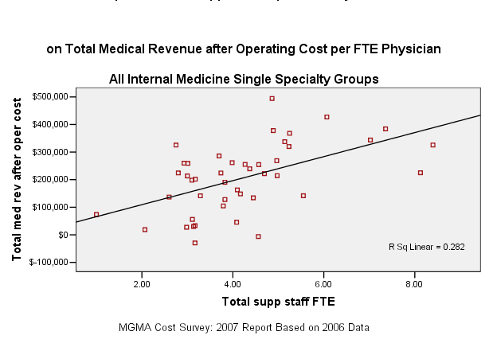
The Business Case
Net Revenue after Operating Costs per FTE MD
MGMA Cost Survey: 2007 Report Based on 2006 data
Notes:
Investing in the personnel infrastructure results in a better practice model in terms of satisfaction, and also a better business model.
as the data supports my experience that investment in infrastructure support has a positive ROI in terms of physician productivity and thus salary
(and perhaps most importantly I believe we would find a similar linear relationship between # of support staff and physician satisfaction and probably also to quality of care.)

Slide 63
Questions
or
Comments?

Slide 64
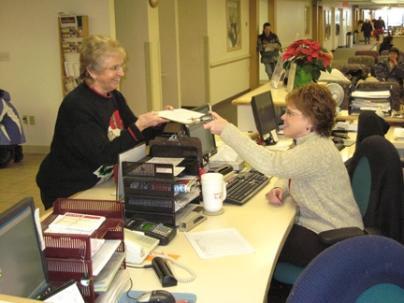
Pre-appointment Questionnaire
Planned Care Appt
Visit Planner
Empowered Team
Pt. Questionnaire
Prescription Mgm’t
Annual Exam
Rapid Access
Intentional Behaviors
Identifies patient’s agenda
MD plan visit before entering
Notes:
Instantmedicalhistory.com

Slide 65
Pre-appointment Questionnaire
Systems approach
  Update PFSH
  Complete ROS
  Behavior issues:
    exercise, smoking, alcohol
Future
  Kiosk
  Web portal
Notes:
Instantmedicalhistory.com

Slide 66
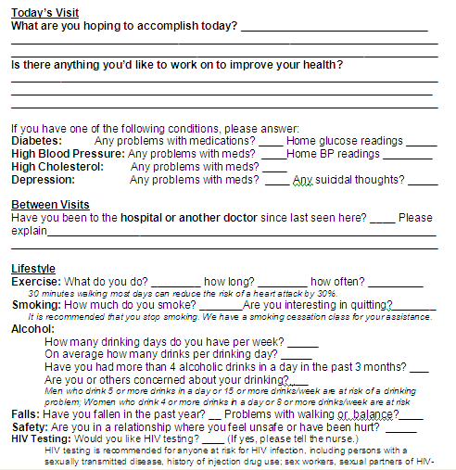

Slide 67

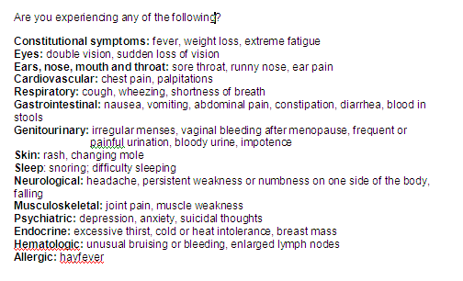

Slide 68
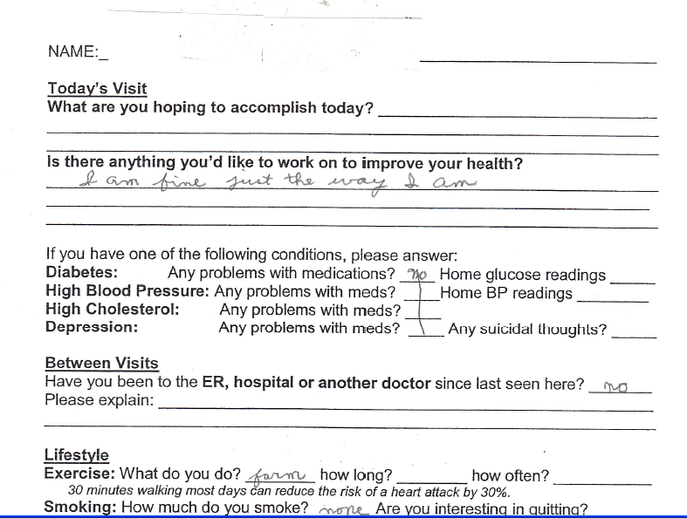

Slide 69
Prescriptions are killing us…my nurse is spending so much time on refills that we can’t seem to get anything done.
Minnesota Family Physician
2007

Slide 70

Prescription Management
Planned Care Appt
Order sets
Empowered Team
Pt. Questionnaire
Prescription Mgm’t
Annual Exam
Rapid Access
Intentional Behaviors
Others: 1RN: 6 MDs
Survey: majority calls for scripts
Systems: all scripts 1 yr at annual
Efficiency: ↓ phone calls by 50%

Slide 71
Prescription Management
Planned Care Appt
Order sets
Empowered Team
Pt. Questionnaire
Prescription Mgm’t
Annual Exam
Rapid Access
Intentional Behaviors
Synchronized, Bundled Renewals
  All scripts renewed and resynchronized at annual visit
  90 d + 4 refills (15 mo)
  (MI 12 mo)
Notes:
Prescribers may not realize that even casual decisions about the quantity of long-term medications to dispense can have important clinical outcomes. A recent study found that women who received 12-month supplies of oral contraceptives rather than 3-month supplies had a 30% decrease in the risk for unintended pregnancies and a 46% decrease in the risk for abortion (45).
45. Foster DG, Hulett D, Bradsberry M, Darney P, Policar M. Number of oral contraceptive pill packages dispensed and subsequent unintended pregnancies. Obstet Gynecol. 2011;117:566-72. [PMID: 21343759]

Slide 72
Prescription Management
Planned Care Appt
Order sets
Empowered Team
Pt. Questionnaire
Prescription Mgm’t
Annual Exam
Rapid Access
Intentional Behaviors
We don’t use scripts as hook or enforcer
  Separate monitoring from renewing
Avoid loading interval visits with unnecessary, redundant work

Slide 73
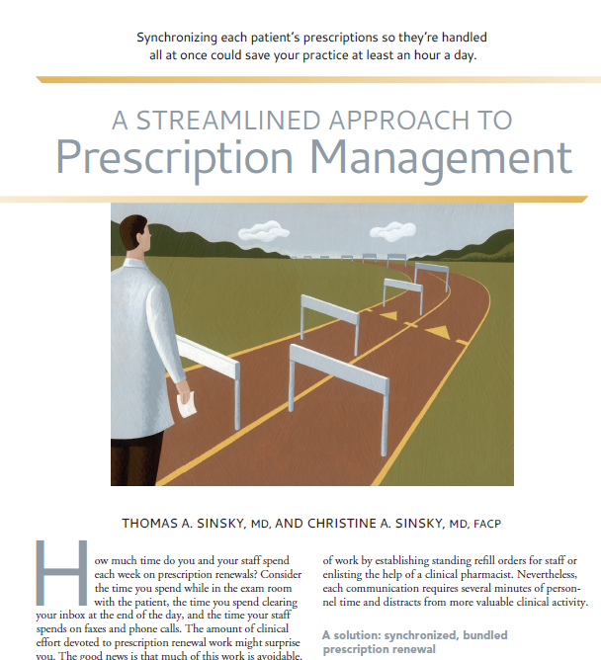
Prescription Management
Fam Pract Manag. 2012 Nov-Dec;19(11):11-15
Notes:
Another reference:
Obstet Gynecol. 2011;117:566-72

Slide 74
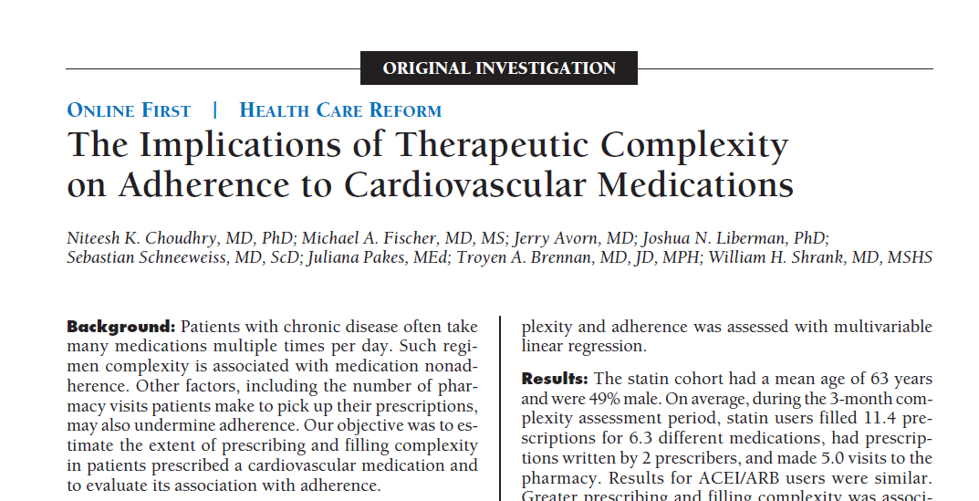
Prescription Management
Refill consolidation →greater adherence
Arch Intern Med. 2011;171(9):814-822.
Notes:
Another reference:
Obstet Gynecol. 2011;117:566-72

Slide 75
Prescription Management
(eliminate waste, improve access)
Physician time
  0.5 hour/day
Nursing time
  1 hour/day per physician
80 million PC visits/year
350,000 PCPs x 220d/yr x1 visit/d

Slide 76

Annual Comprehensive Care Visit
Planned Care Appt
Order sets
Empowered Team
Pt. Questionnaire
Prescription Mgm’t
Annual Exam
Rapid Access
Intentional Behaviors
Dedicated appt
  prevention/annual chronic dz
  synchronize and renew meds
Customized
  not one-size-fits-all

Slide 77
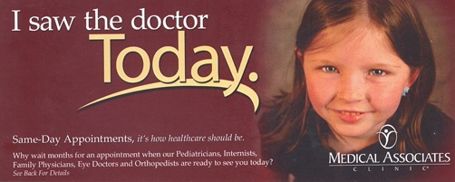
Rapid Access
Planned Care Appt
Order sets
Empowered Team
Pt. Questionnaire
Prescription Mgm’t
Annual Exam
Rapid Access
Intentional Behaviors
Scheduling for same day access
Today not Triage
Triage takes time
  30 sec “yes”, 5 min “no” “later”
Pt’s don’t have to plead case

Slide 78
Questions
or
Comments?

Slide 79

Integrated, Continuous Care
Patient Centered Medical Home
Lab
Mammo
Mammo
Sept
Mar
Planned Care
Comprehensive
L
A
B
HTN
⁭ Chol
⁭ Glucose
Osteoporosis
Depression
O
R
D
E
R
S
L
A
B
HTN
⁭ Chol
⁭ Glucose
Osteoporosis
Depression
Lipids,FBS
Cr, K, Mam
O
R
D
E
R
S
S
C
R
I
P
T
S
LDL 75,
A1c 6.2
Nurse-MD Team
Prevention
Efficiencies and care coordination
Same Day
Surgery Appt

Slide 80
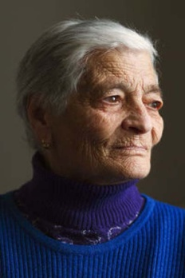


Integrated, Continuous care
Dec
Comprehensive
Architecture
Of
Care
Nov
L
A
B
HTN
DM 2
Depression
O
R
D
E
R
S
S
C
R
I
P
T
S
Hospital
CHF
FBS, A1c, lipids, alb,
mammo
INR
CHF
Education/
Clinic
Prevention
Home Care
Mar
Sept
Planned Care
Planned Care
L
A
B
HTN
DM 2
Depression
O
R
D
E
R
S
L
A
B
HTN
DM 2
Depression
O
R
D
E
R
S
Diabetic
Education
Family
Nurse-MD Team
A1c 7.1
LDL 145
FBS, A1c
CXR
Efficiencies and care coordination
Aug
Apr
Jun
Rapid
Access
Pneumonia
Rapid
Access
PMP Hg
Planned Care
L
A
B
HTN
DM 2
Depression
O
R
D
E
R
S
FBS, A1c
Lipids
INR

Slide 81
How innovations relate to Patient-Centered Medical Home?
Standing orders
In-box management
In-visit scribing
Pre-visit planning
Health Coaching
Share the Care
Huddles
Panel management
Care Coordination
Co-location
Team meetings

Slide 82

Patient-Centered Medical Home
Standing orders
In-box management
Scribing
Pre-visit planning
Health Coaching
Access and Continuity
Manage Populations
Plan and Manage Care
Self-Care and Support
Track and Coordinate Care
Measure/Improve Performance
Share the Care
Huddles
Panel management
Care Coordination
Co-location
Team meetings

Slide 83
Intentional Behaviors
Planned Care Appt
Order sets
Empowered Nursing
Pt. Questionnaire
Prescription Mgm’t
Annual Exam
Rapid Access
Intentional Behaviors
Eye contact/physical touch
Key phrases
  What else do I need to know?
  Did we cover everything you wanted?
  How are you handling this?

Slide 84
Intentional Behaviors
Planned Care Appt
Order sets
Empowered Nursing
Pt. Questionnaire
Prescription Mgm’t
Annual Exam
Rapid Access
Intentional Behaviors
More Key phrases
  Tell me about yourself
  What do you do for fun?
  Could you bring me a picture of ….at your next appointment
Social notes at end of dictation

Slide 85
Sister Mary Owen, what have you been up to lately?

Slide 86

Sister Mary Owen, what have you been up to lately?

Slide 87

Sr. Mary Owen, what have you been up to lately?

Slide 88
At the center of PCMH are face-to-face healing relationships.
Patient: Nurse
Nurse: Physician
Nurse: Nurse
Patient: Physician
Notes:
Building the physical and human infrastructure that puts human relationships at the center of our care.

Slide 89
We will know who you are and we will be ready for you.
Borgess Ambulatory Care, Kalamazoo, MI

Slide 90

Discussion

Slide 91



In Their Own Voices

Slide 92
I assume the years
of effective work are limited,
so I do not hold back.
This is more liberating
Than earlier years
When a bit of open mindedness
Seemed terribly daring,
Or a sense of abundance of time
Slowed inquiry.
Thank you for being interested.
Carolyn Handy, artist, age 82

Slide 93




Slide 94




Slide 95
I’m trying to think of questions doctors ask.
“How have your blood sugars been?”
Always that question.
The question I would rather hear
or would like to hear in addition to that,
is about non-medical stuff.
It’s like they could simply ask,
“How was your trip here?
I think that’s all I crave, you know, not everything
revolving around diabetes.

Slide 96
It would seem really easy
for the doctor to jot
any simple personal anecdote,
In my chart and ask about it.
It really connects me with them
And I’m much more able to receive advice
From people I feel are thinking of me
as a person
rather than just
the next patient.
Andie Dominick in Patient Listening: A Doctor’s Guide, Loreen Herwaldt

Slide 97



Slide 98


Slide 99


She is more
than her
fibromyalgia
Notes:
Patient whom I only knew for her fibromyalgia and obesity.
Pt gave permission for use of this slide, with her diagnosis and picture, on 10.14.08

Slide 100


99 Years Old and Still Running

Slide 101
When I get bored with my work I realize I’m not paying attention to my patients and their stories.
Family Physician, WI, 2008

Slide 102

Notes:
Dr. Bjork: physicist, taught computer science in college; developed MS; invented several adaptive devices to help, including a lift device that can go on the door jam of a hotel (and that folds up into a suitcase) for traveling; it is under patent with UW; can move his chair, tilt the chair, and surf the internet using his lower lip on the cork ball; has a microphone head set and an amplifier that he uses to make his speech audible. Has written two books since being quadriplegic on the intersection of science and religion; MAHP covered the cost of his wheelchair; has a g-tube now, he and his wife are eternally optimistic and said the only change for them is that they will now have to remind his grown sons (4) that they can’t pick him up and throw him in the water. UW Platteville has a lift into the pool that he would love to use, it would drop him down into the water for the sensation of it, he used to love to swim.

Slide 103
I have to keep reminding doctors,
As well as myself,
Not to let illness
define me.
It’s in attendance, but
it’s not all
I am.
Marva Dawn in Patient Listening: A Doctor’s Guide, Loreen Herwaldt

Slide 104
For Rossi, on Admission to Medical School
On this last day of my doctoring
I give you my guessing tubes,
My blue, not new, stethoscope
It is a Littman
Bought in Boston
With Cynthia in 1987
It has heard the whole range of murmurs,
Clicks, taps, knocks, plops, opening snaps
And also Morris Minor piston slap

Slide 105
It has heard first breaths
Last breaths and no breaths
Between my ears
It has generated interest,
Pride, puzzlement, and fear
By the time you graduate
It may be obsolete,
And auscultation all electronic

Slide 106
But keep it discretely
Do not flaunt it
Or misread this gift
I give it to remind you
That the essence of medicine
Lies in listening
Rae Varcoe, MA, MBChB
Ann Intern Med 2010;153:44

Slide 109


Slide 112
Thank You

Slide 114
Resources
Improving Office Practice: Working Smarter, Not Harder. Family Practice Management: November/December 2006 Vol. 13, No. 10 http://www.aafp.org/fpm/20061100/28impr.html
Building Teams in Primary Care: 15 Case Studies. Bodenheimer. www.chcf.org

Slide 115

“Medical care must be provided with utmost efficiency. To do less is a disservice to those we treat, and an injustice to those we might have treated.”
Sir William Osler, 1893
115
Notes:
115

Slide 116

Reflective Listening

Slide 117

From Mary Applegate MD

Slide 118


