Slide 1

Community Resources
Care Manager Meeting 9/12/19
Notes:
Introduce self etc
Lay out the next few minutes
Hoping to have good conversation etc.

Slide 2

Name
Practice Name
How did you end up in care management (CM)?
How long have you been working in CM
Introduction
Notes:
Group Intro
Going onto questions
Please done hesitate to speak up

Slide 3

What groups/agencies do you use?
Notes:
From the emails some of you mentioned using:
Community on Again
Local therapists
Michaels place? – Shelly W.

Slide 4

What ones are the best?
What Ones are The hardest to work with?
Notes:
Not difficult to work with- Shelly Wood

Slide 5
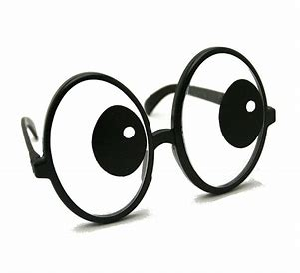
How do you find out about them?

Slide 6

What resources do you need
Notes:
More resources on housing/ how to access/ brochures for patients- Shelly W.
TBIM0 housing; Women's Resources Center ( what do they do/ what do they offer: besides crisis

Slide 7

What Groups/ businesses/ types of resources would you like to see at a community resource fair
Notes:
Want- Local housing commission – Shelly W.

Slide 8

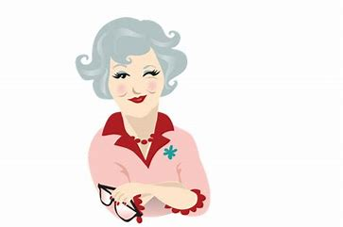

211 Or Aunt Bertha have you used it?
Have you heard of patients using it?
Notes:
Have not uses- Shelly W.

Slide 9

Things to keep in mind
Domain 10: Linkage to Community Services
  2-1-1/ Aunt Bertha not good enough
  Need to establish direct relationships with the resources
  Need to be able to track

Slide 10
Things to keep in mind
The American Academy of Family Physicians
  Key Functions of a Medical Home
    Community Resources Relationship Building
      Suggests using Aunt Bertha
        Find needed resources
        Up date resources
Cerner EMR/HER Users can utilize Aunt Bertha with the Cerner System
  Video to come
  https://www.aafp.org/practice-management/transformation/pcmh/key-functions/comprehensiveness-coordination.html

Slide 11
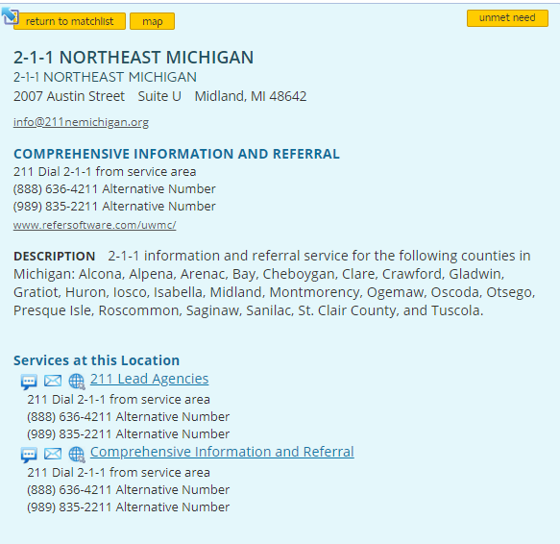
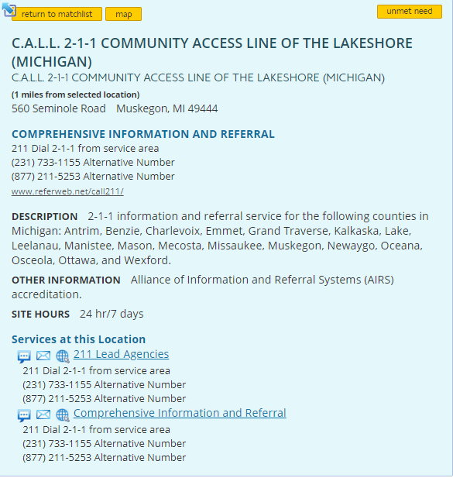
21
1

Slide 12

https://www.auntbertha.com/ https://company.auntbertha.com/sales-demo/
Aunt Bertha
Notes:
Go to website; put in TC zip code and show an example of how to search for resources or to click on a topic

Slide 13
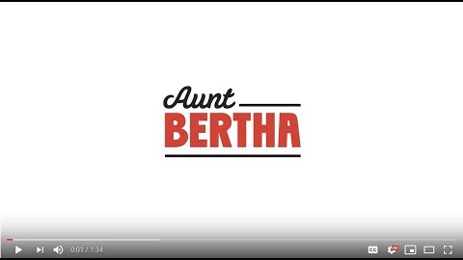

Slide 14
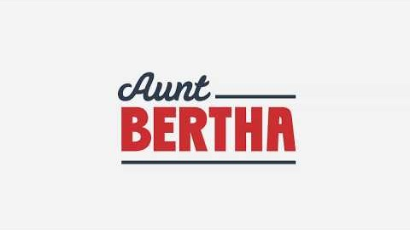
Notes:
I want stress the that my intent is not for you to just start using Aunt Bertha
I really want to know your wants/ needs/ suggestions etc
For Community R Fair- in order to help your practiced with the linkage and relationship aspect of Domain 10 and its capabilities
However, I thought this was interesting; wanted to make those who were not aware, aware etc.
Back to our community resource conversation/ questions

Slide 15

How do we improve utilization of community resources ?

Slide 16

What do you think of NPO listing of Resources ?
Do you utilize it?
How can it be Improved?

Slide 17

particular area if improved upon would make a large positive impact on our community?
Notes:
Housing and Legal Resources- Shelly W.

Slide 18
Questions or Comments

